Slide 1
Garden Magic
Landscaping and Design

Slide 2
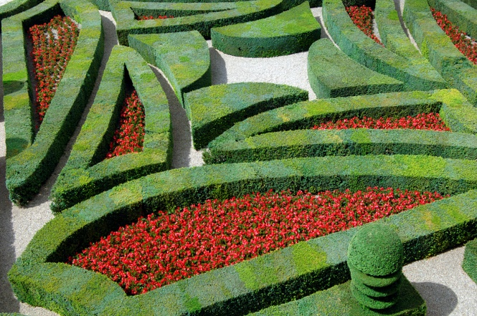
All Work Considered
We provide a full consultation and design service for corporate or private gardens
No job is too small
Competitive rates

Slide 3
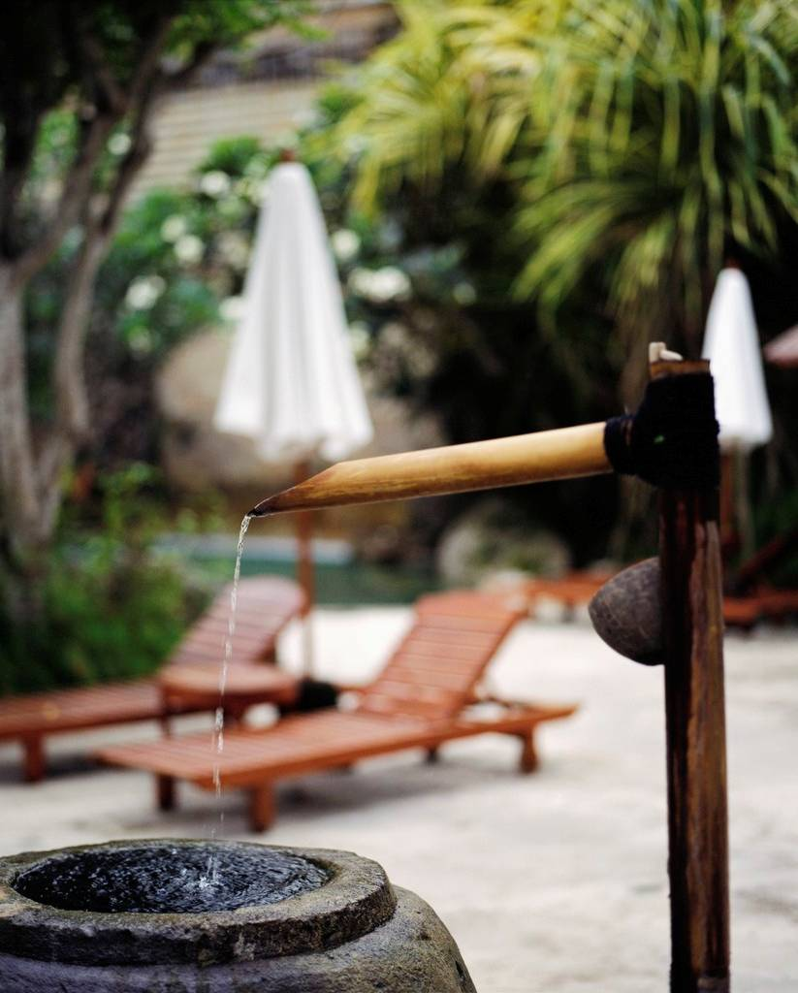
Water Features
We design many beautiful water features
Each creation is unique
High quality pumping systems
Ambient lighting a speciality

Slide 4


Exotic Plants
New for this year we have a wide range of exotic and Mediterranean plants
Used with decking and other natural materials to create a unique look for home or business outdoor space

Slide 5
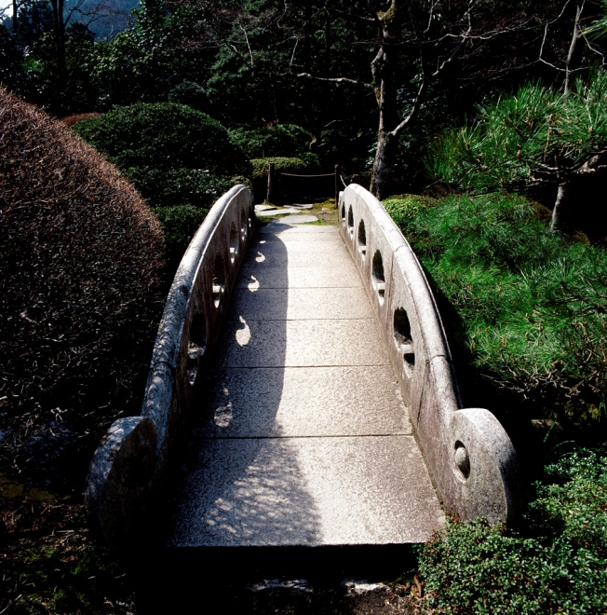
Free Quote
For a no obligation free quotation during a visit to your premises, contact Alan on 0198 123456
Alternatively visit our showroom at Mallard Way, Little Wynding, Othershire

