Slide 1
Cats Protection League
North East Region

Slide 2
Help Prevent Cruelty to Cats
Find out about our charity
Locations of our Catteries
Locations of our Shelters
How to make a donation
How to volunteer your time
About our low cost veterinary service

Slide 3
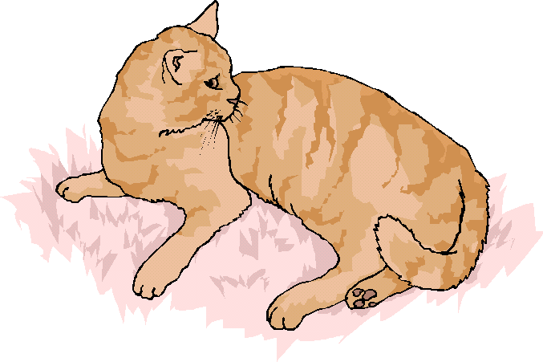
About us…..
The Cats Protection League was Established in 1972 by Jane Freeman
We now have over 120 members within the North East and over 2,000 members countrywide.
Over £500,000 is raised annually to help prevent cruelty to Cats.

Slide 4
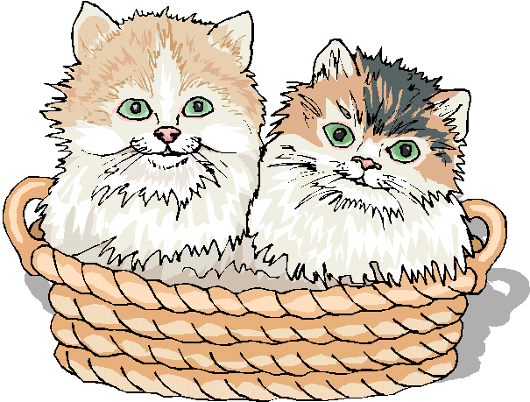
Locations of our Catteries
While on Holiday why not ensure your cat’s good health and well being are taken care of in one of our Catteries?
Not only will your cat be looked after by one of our trained staff, you will also be helping our charity.
jdkldjf
Tynemouth
Sunderland

Slide 5
Locations of our Shelters
We have six shelters within the region, which house over 500 lost or neglected cats.
Come and visit one of our shelters to find the purrrfect cat for you.
Blaydon
Gateshead
Newcastle
Rowlands Gill
Sunderland
Whitley Bay

Slide 6
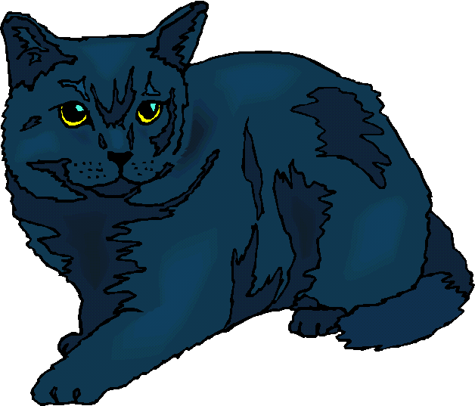
How to make a donation
If you would like to make a donation to our cause, please send a cheque or postal order payable to:- The Cats Protection League 23 The Ridings Newcastle NE1 6PG
Thank you for your support

Slide 7
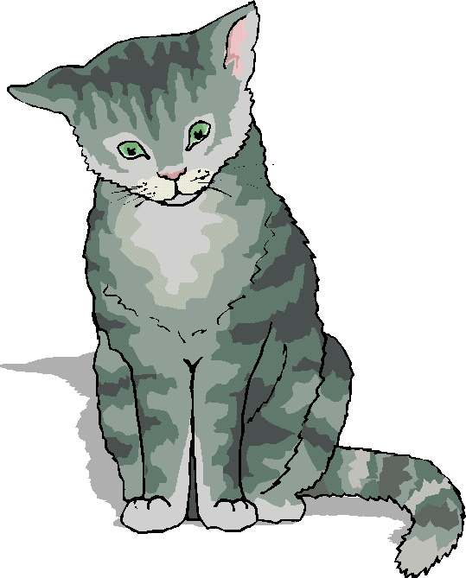
How to Volunteer
We are always looking for voluntary help within our Catteries and Shelters.
If you have any hours to spare each week, please contact Mrs Claire Wilson on (0191) 384 7267 to discuss how you could help.

Slide 8
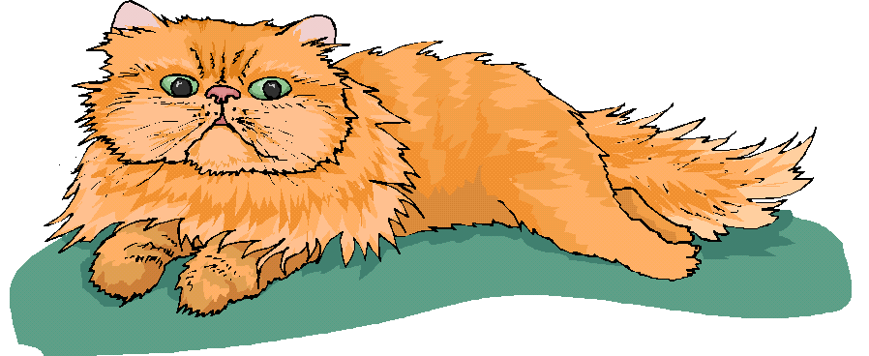
Low cost veterinary service
The Cats Protection League has a subsidised veterinary service for those pets whose owners are on a low income.
For other owners who are not on a low income we require a donation rather than charge a fixed rate.

